Slide 1
Connecting RStudio and Github
Ashwin Malshe

Slide 2
Resources
GitHub.com
Managing Git(Hub) Credentials: https://usethis.r-lib.org/articles/git-credentials.html
Connect RStudio to Git and GitHub: https://happygitwithr.com/rstudio-git-github

Slide 3
Steps
Create a GitHub.com account. Note down the email address you use to create the account and run the following command in the terminal: git config --global user.email “Your Email”
In RStudio install usethis package by executing following command in the console: install.packages(“usethis”)
Run, the code on the next slide

Slide 4

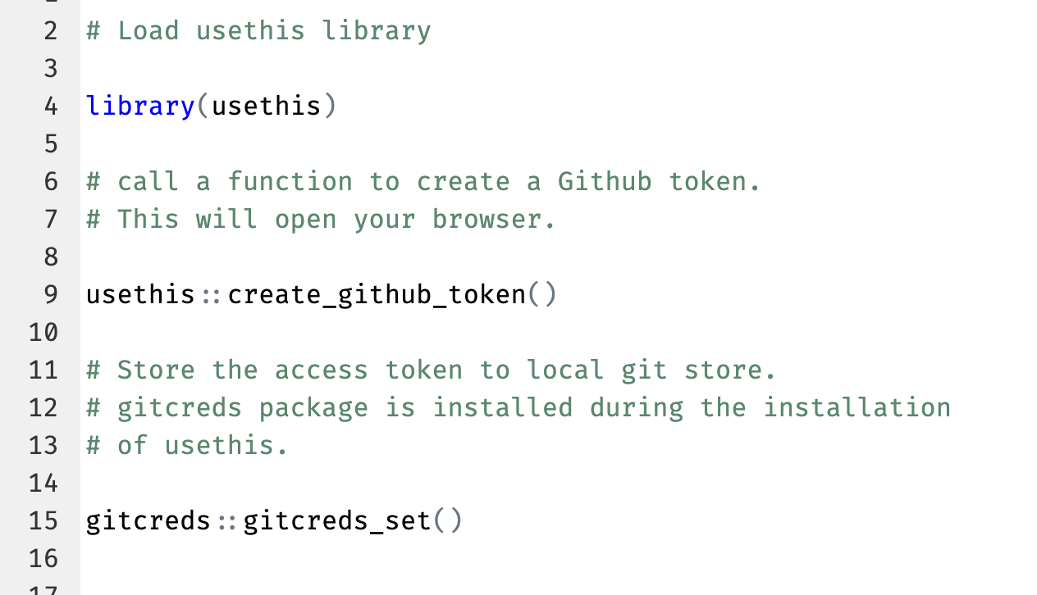

Slide 5

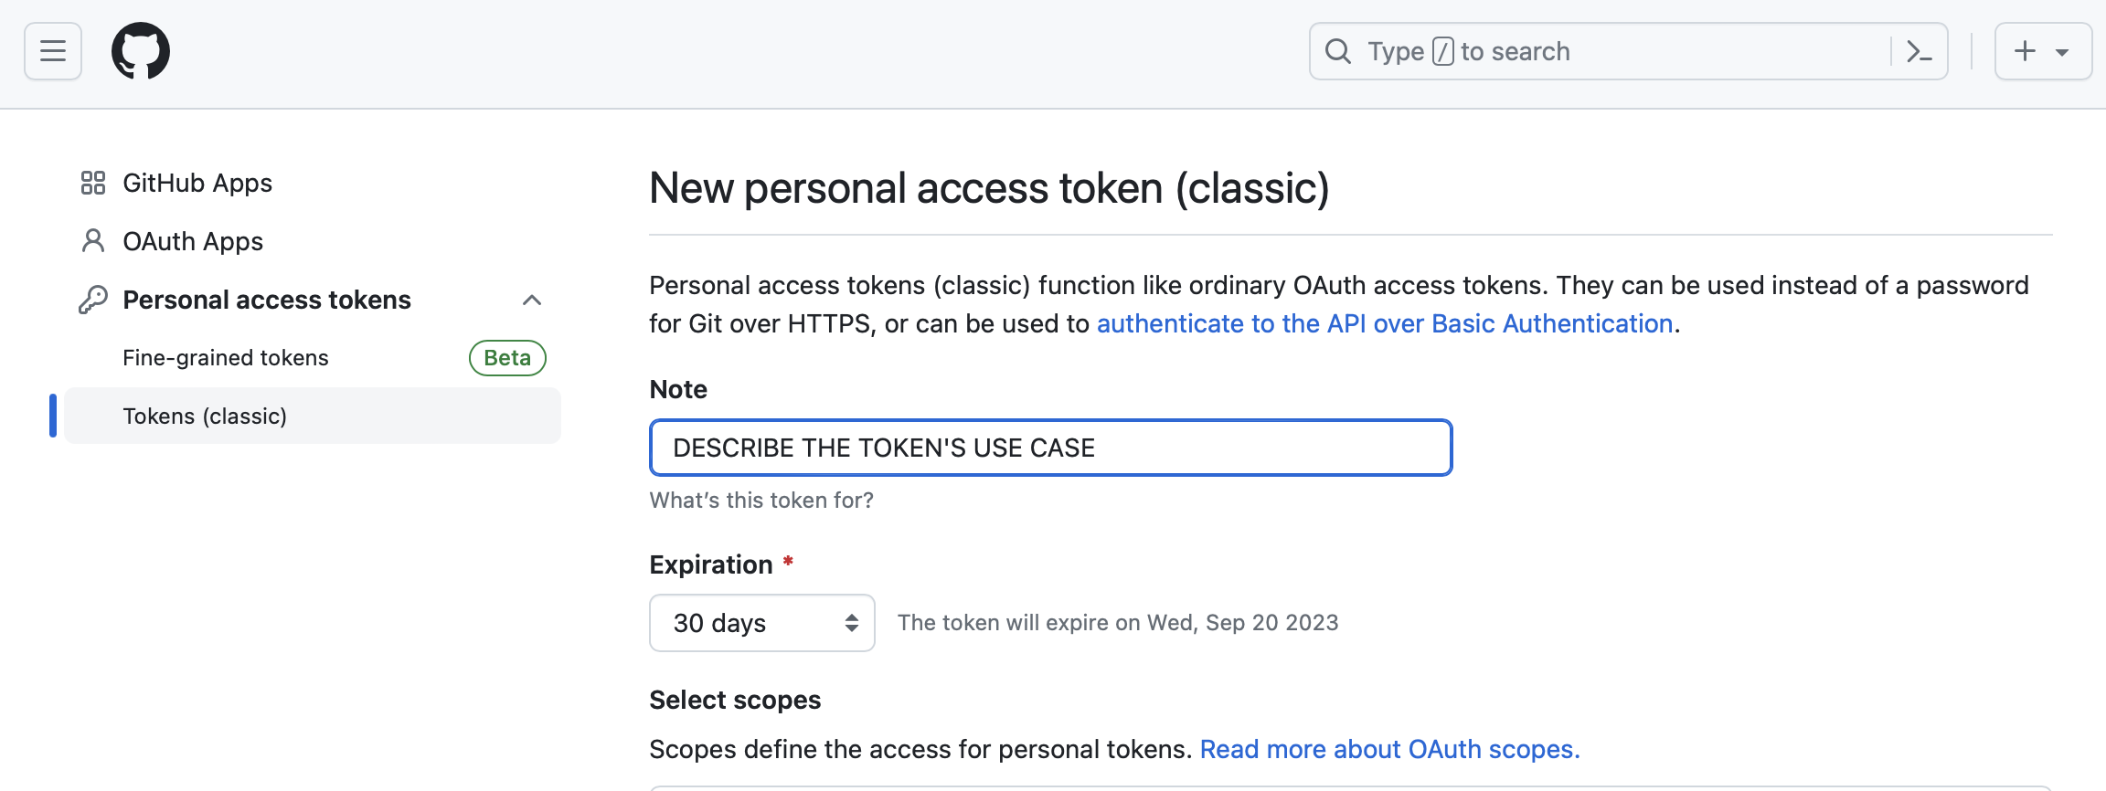

Slide 6

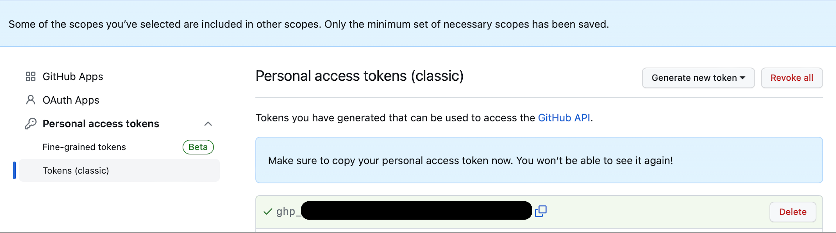

Slide 7


Step 4. Create a new repository on Github

Slide 8

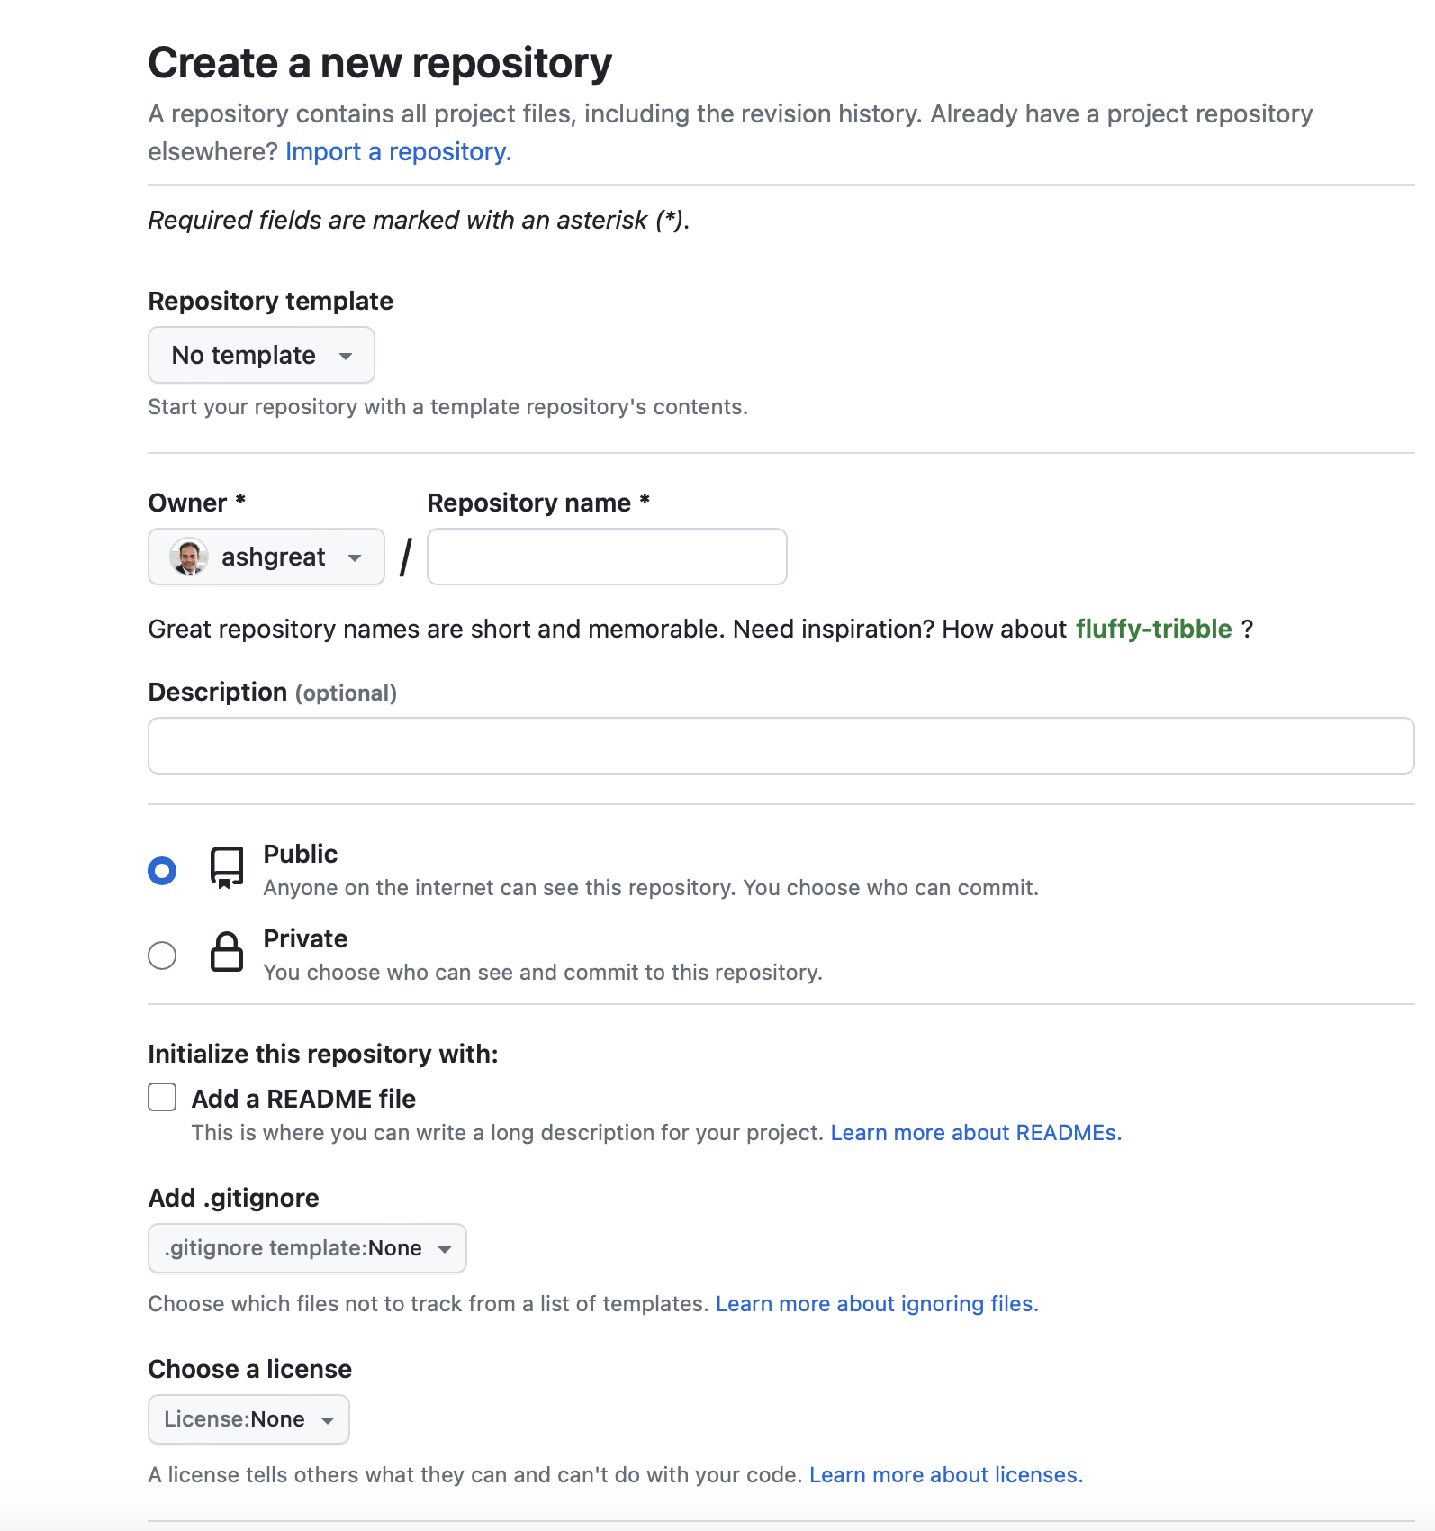

Slide 9

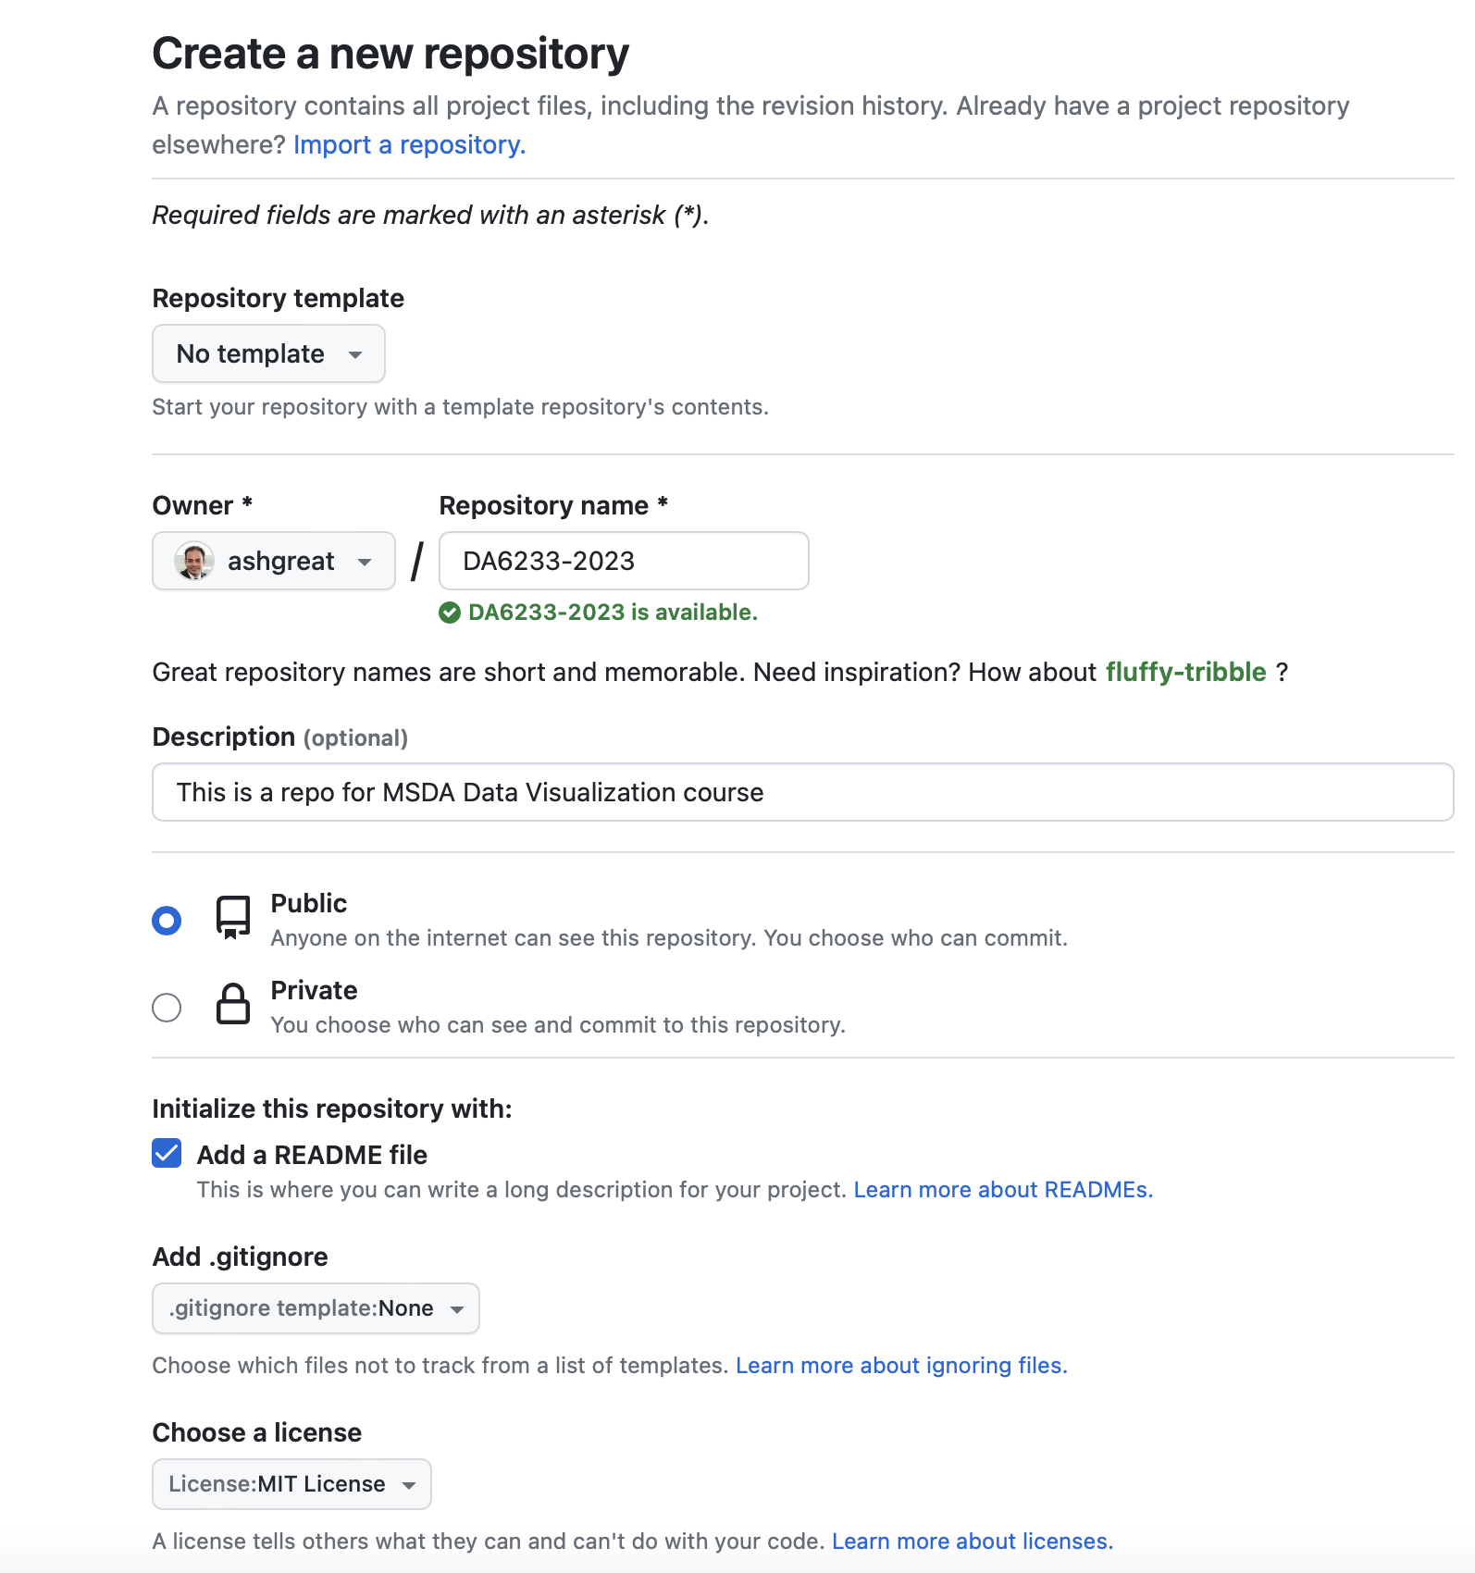

Slide 10

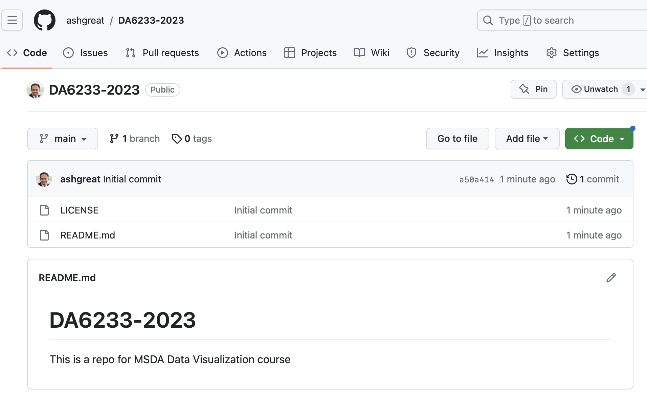

Slide 11

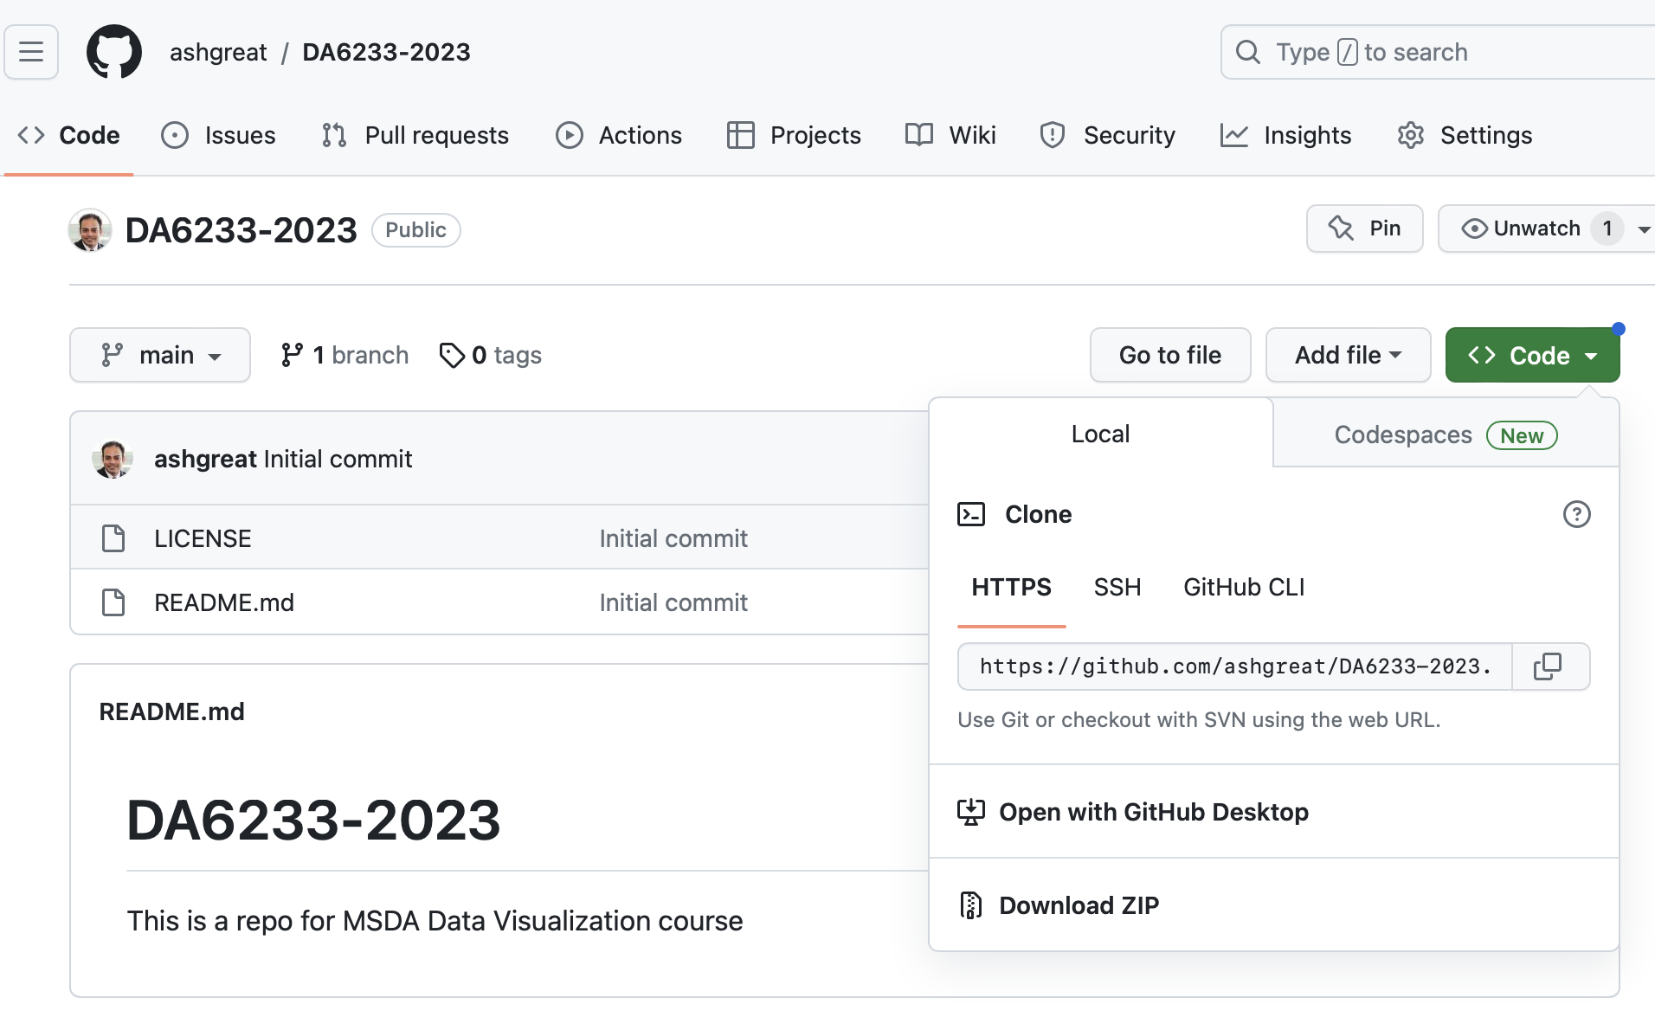

Step 5. Copy the HTTPS URL
Copy

Slide 12
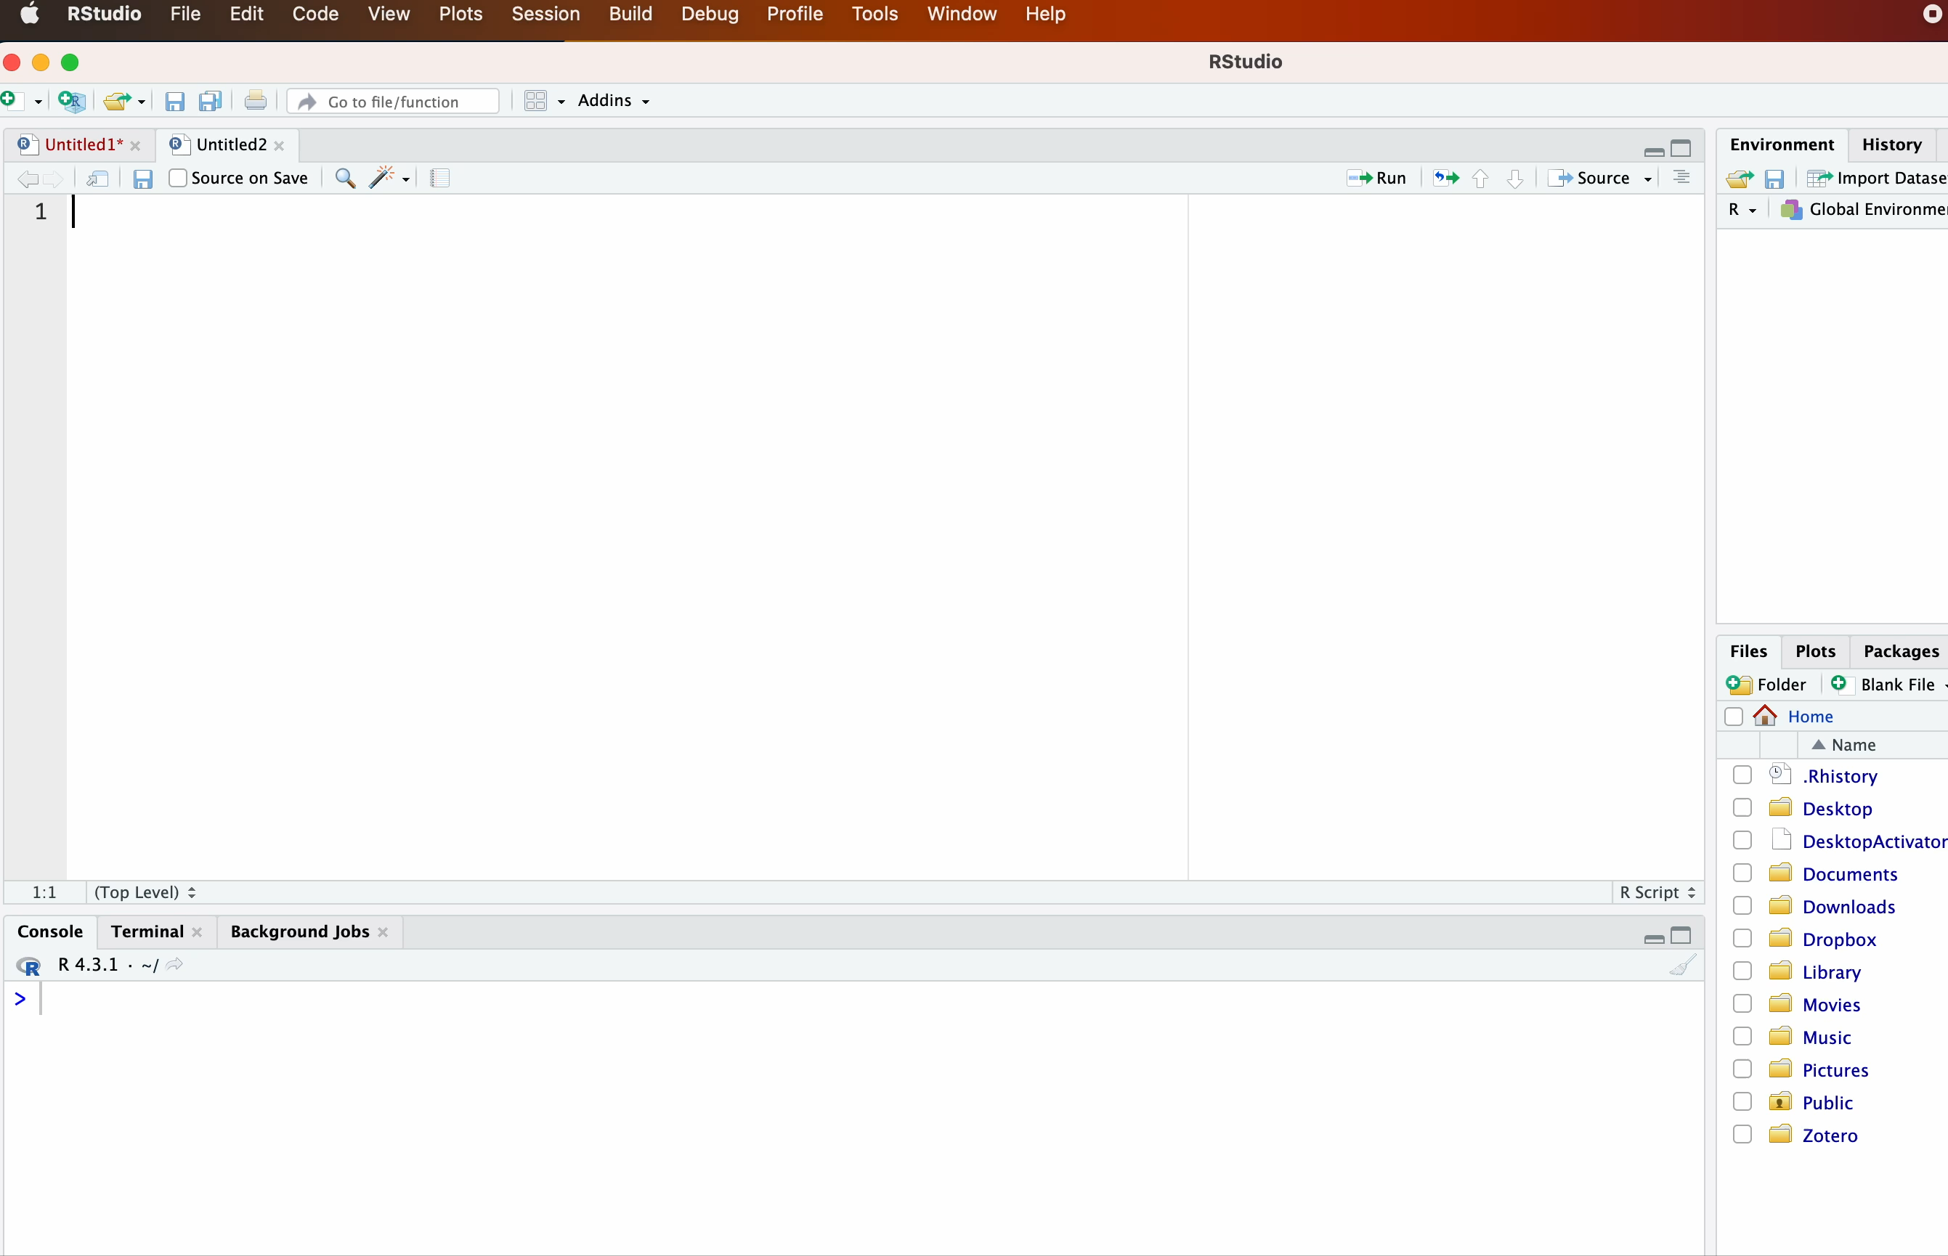
Step 6. Create an RStudio Project

Slide 13
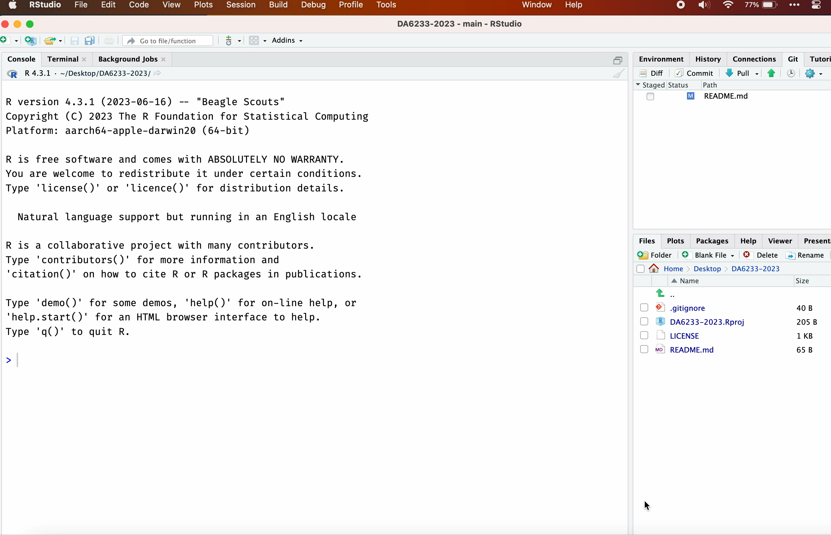
Step 7. Update the Readme file, commit, and push to Github

